Slide 1
Apple Stock Price Analysis & Prediction Using Historical Market Data

Slide 2
MENTOR & TEAM DETAILS
Mentor Name: Sadiya Ansari
Team Members:
Sakshi
Tanguturu Lokesh Babu
Anmol Bhanushali
Raiyana Reyaz
Akash Mahandargi
Koushik B
Sripathi M

Slide 3
OBJECTIVE
To analyze historical stock price data of Apple Inc.
To understand price trends, volatility, and patterns.
To build a predictive model for future stock prices.
To derive actionable insights useful for investors and analysts.

Slide 4
PROBLEM STATEMENT
Stock markets are highly volatile and influenced by multiple factors.
Investors require data-driven insights to support decision-making.
This project aims to leverage historical data to analyze trends and predict prices

Slide 5
DATASET DETAILS
Dataset Name: Apple Inc. (AAPL) Historical Stock Data
Data Source: Public financial market data

Slide 6
DATASET FEATURES
Date
Open Price
High Price
Low Price
Close Price
Adjusted Close Price
Trading Volume

Slide 7
DATA PREPROCESSING
Converted date column to time-series format
Handled missing values
Ensured numerical consistency
Removed duplicates
Prepared data for analysis and modeling

Slide 8
EXPLORATORY DATA ANALYSIS (EDA) OVERVIEW
EDA was performed to:
Understand price distribution
Identify trends and seasonality
Detect volatility patterns
Analyze trading volume behavior

Slide 9
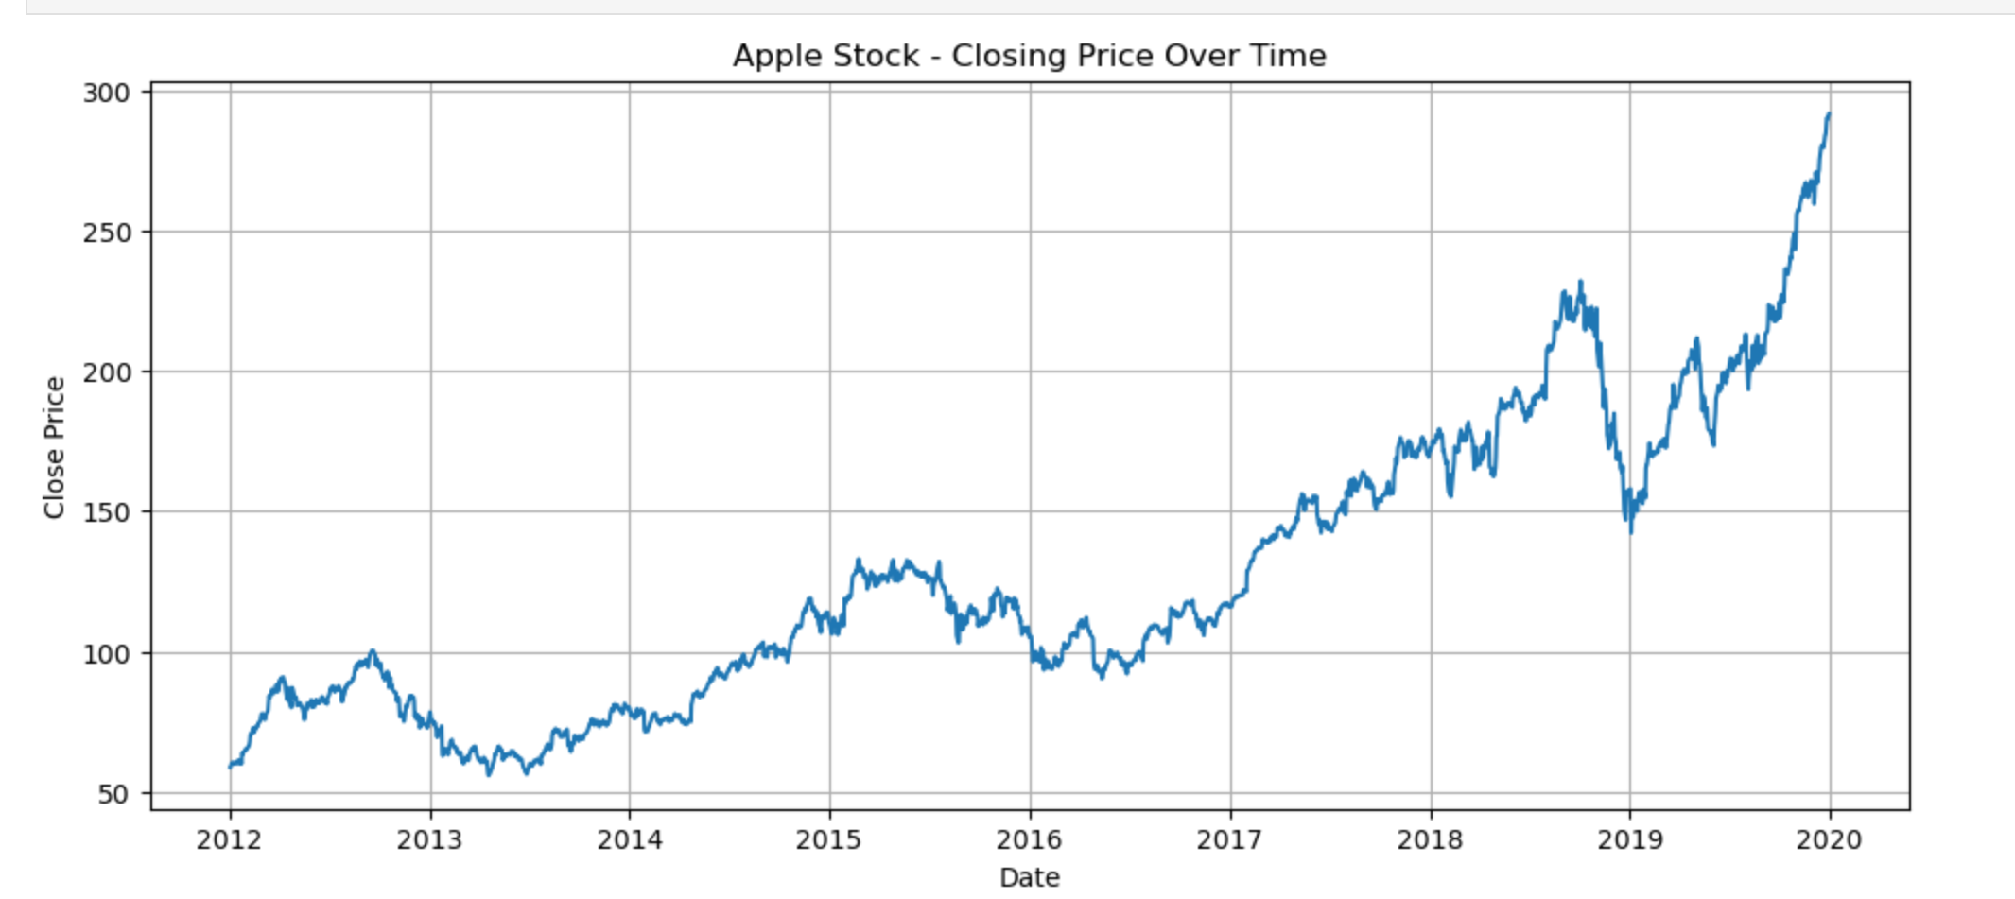
PRICE TREND ANALYSIS
Apple’s stock shows a strong long-term upward trend from 2012–2020, with short-term volatility but significant overall growth.

Slide 10
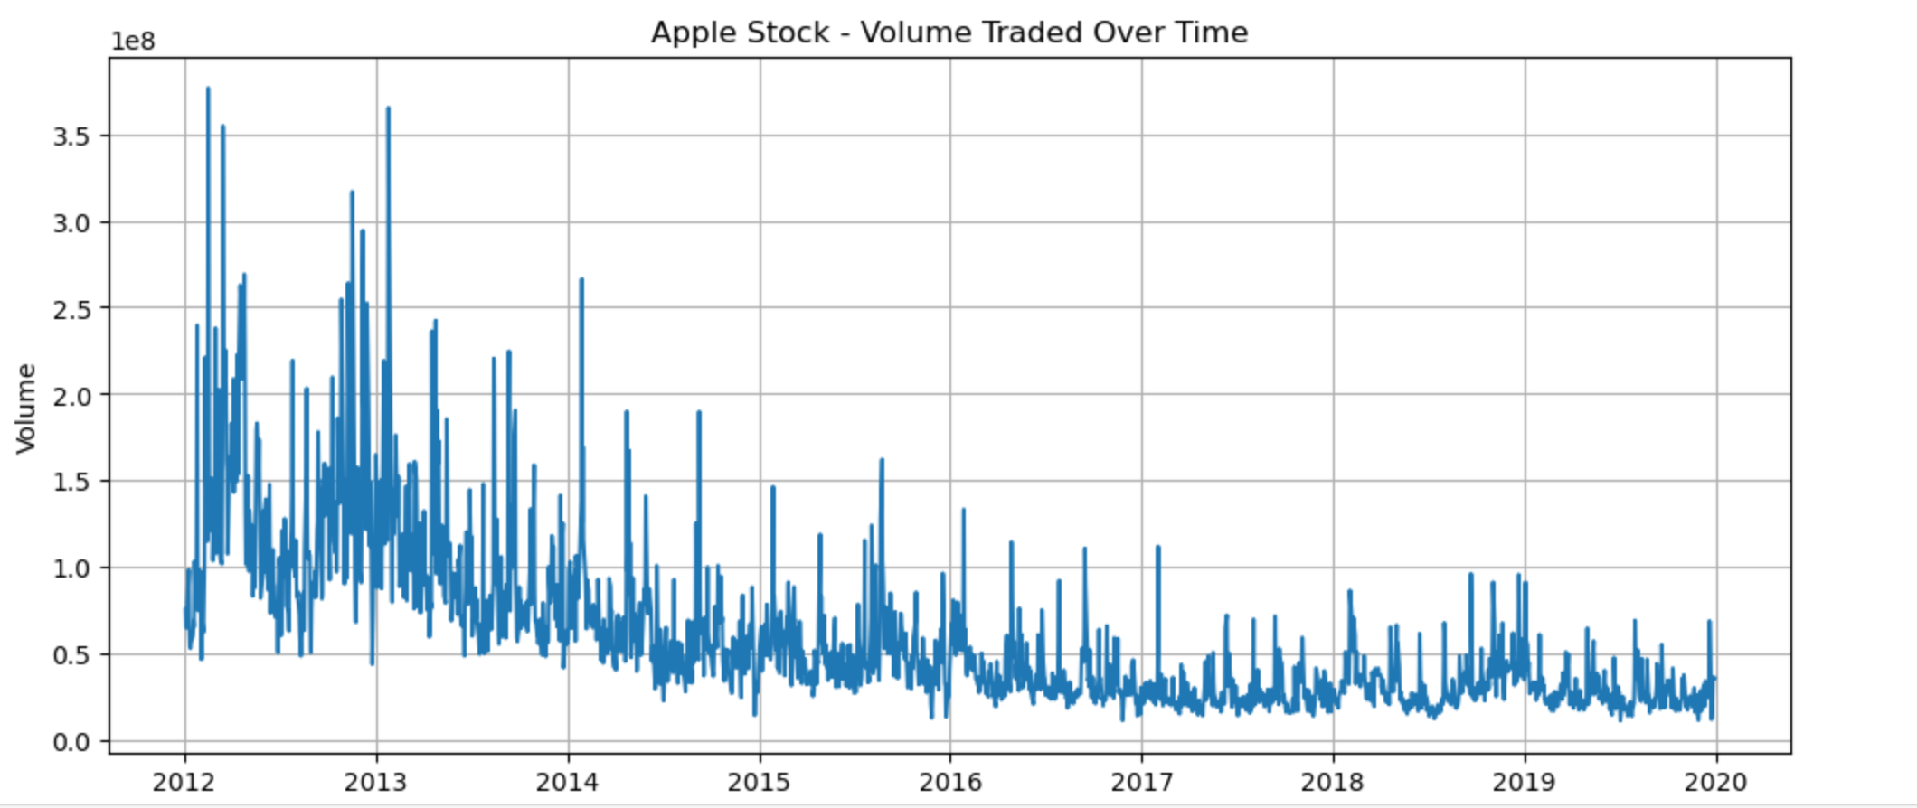
VOLUME ANALYSIS
Apple’s trading volume generally declines over time, with occasional sharp spikes indicating periods of heightened market activity.

Slide 11
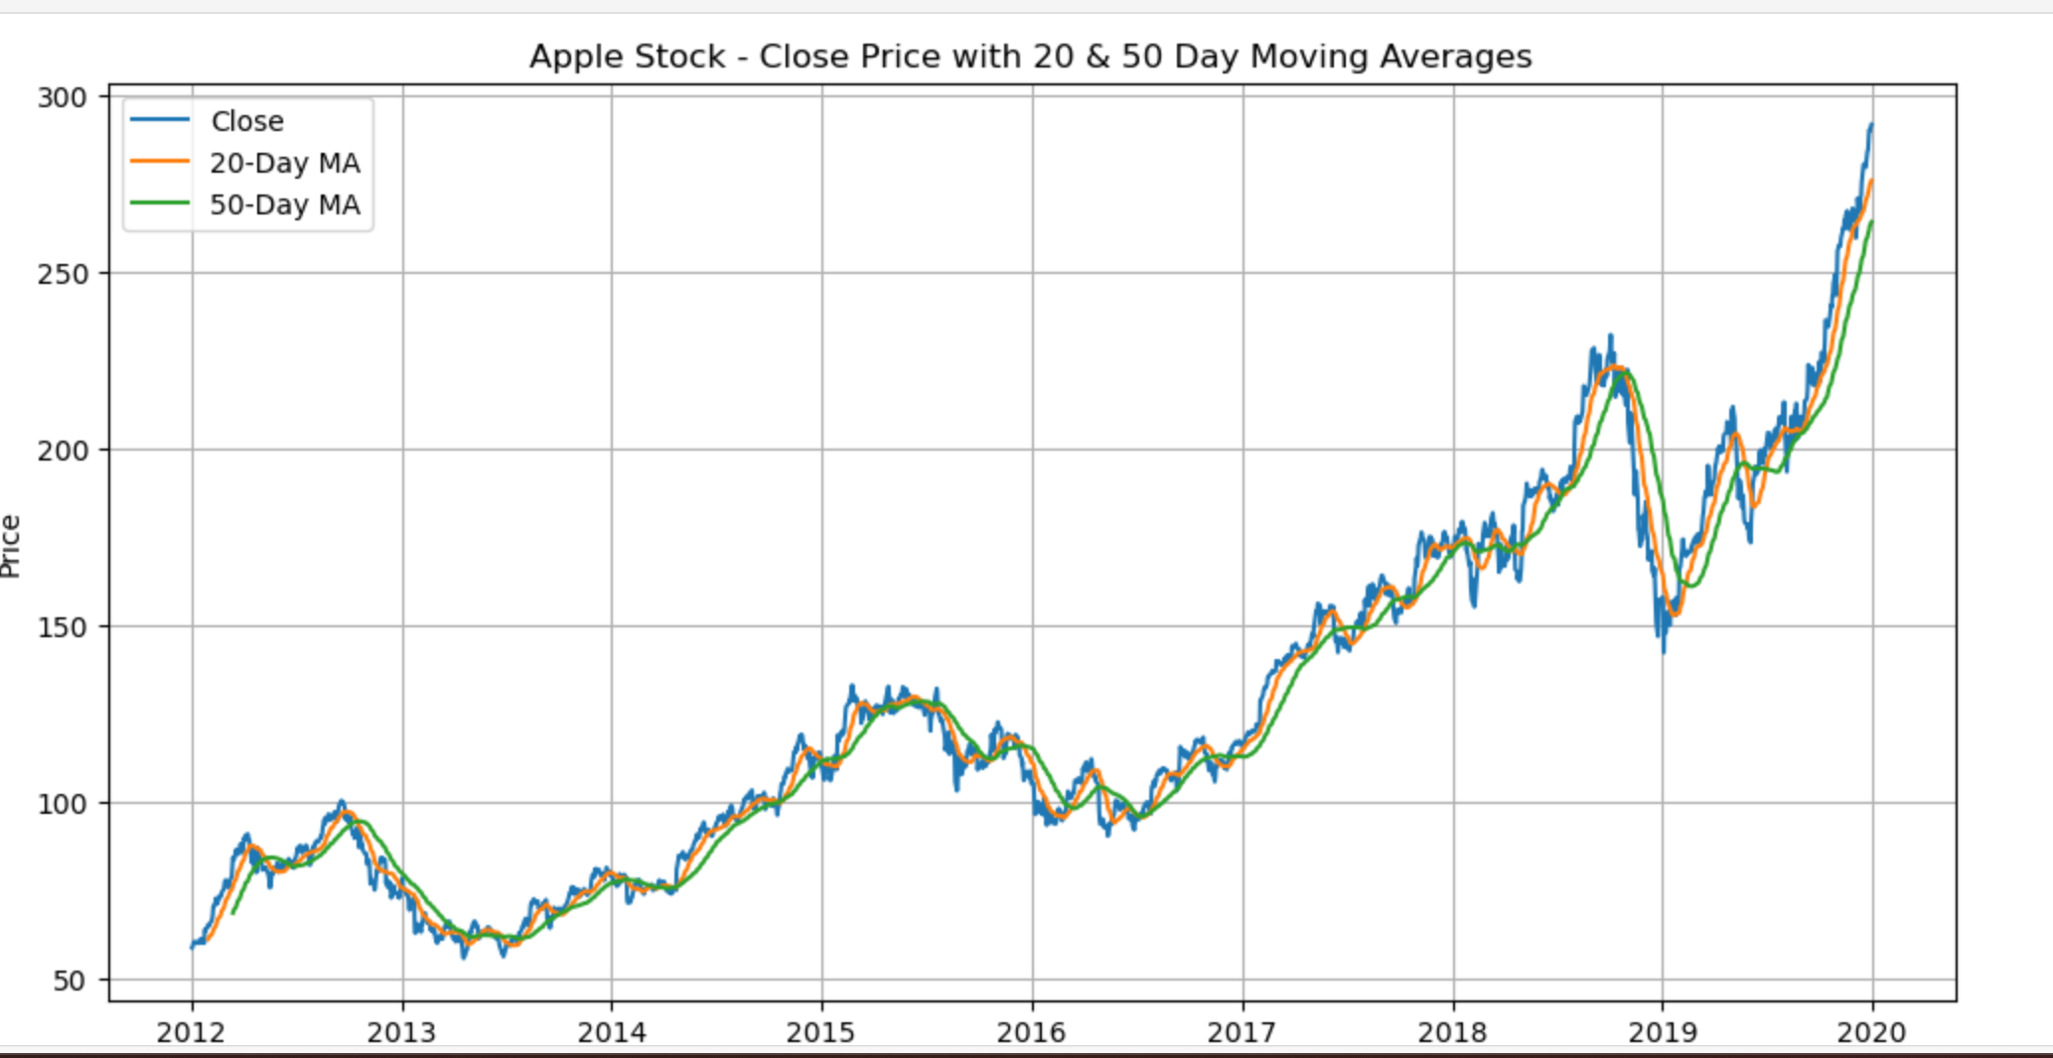
MOVING AVERAGE ANALYSIS
The 20-day and 50-day moving averages closely track Apple’s price, confirming a strong bullish trend with brief pullbacks when the averages converge or cross.

Slide 12
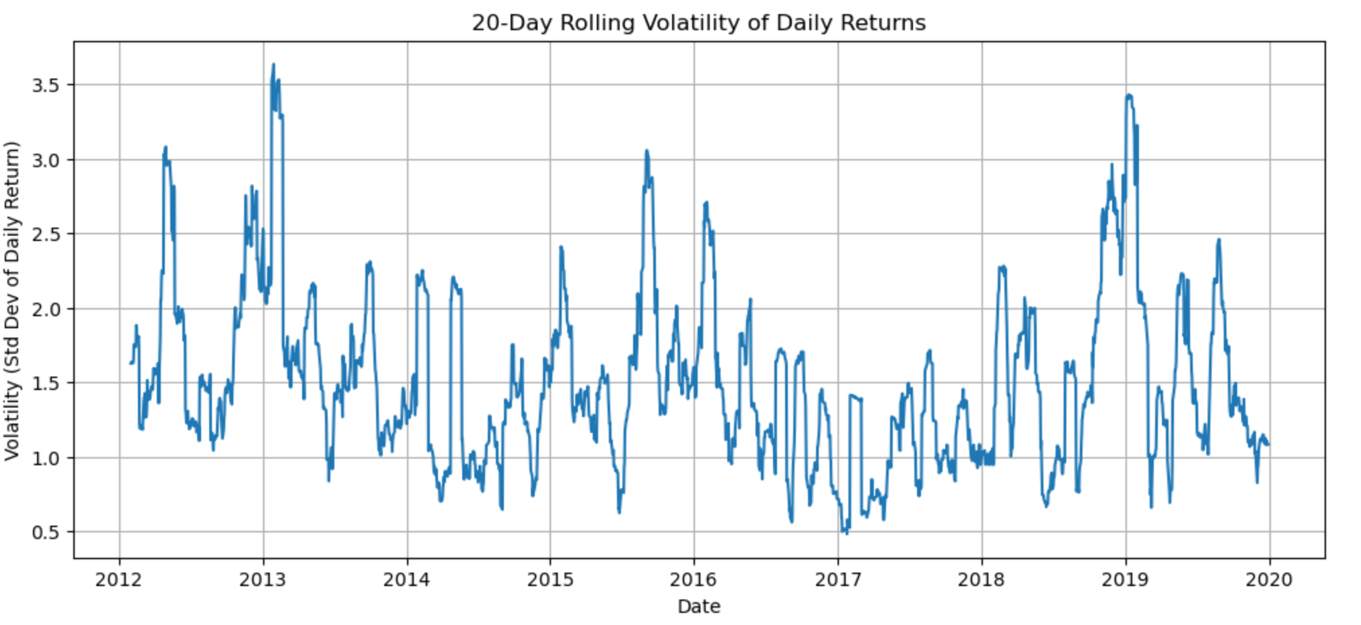
VOLATILITY ANALYSIS
Apple’s return volatility fluctuates over time with periodic spikes, indicating phases of increased market uncertainty amid otherwise stable periods.

Slide 13
FEATURE SELECTION
Key features used for modeling:
Historical closing prices
Lagged price values
Moving averages
Trend-based indicators

Slide 14
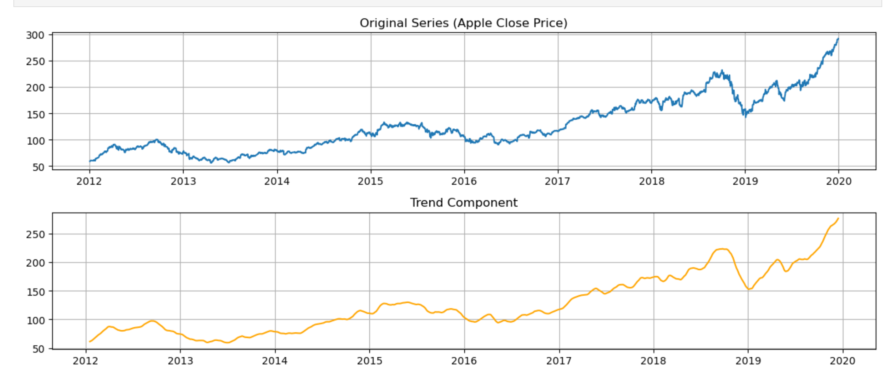
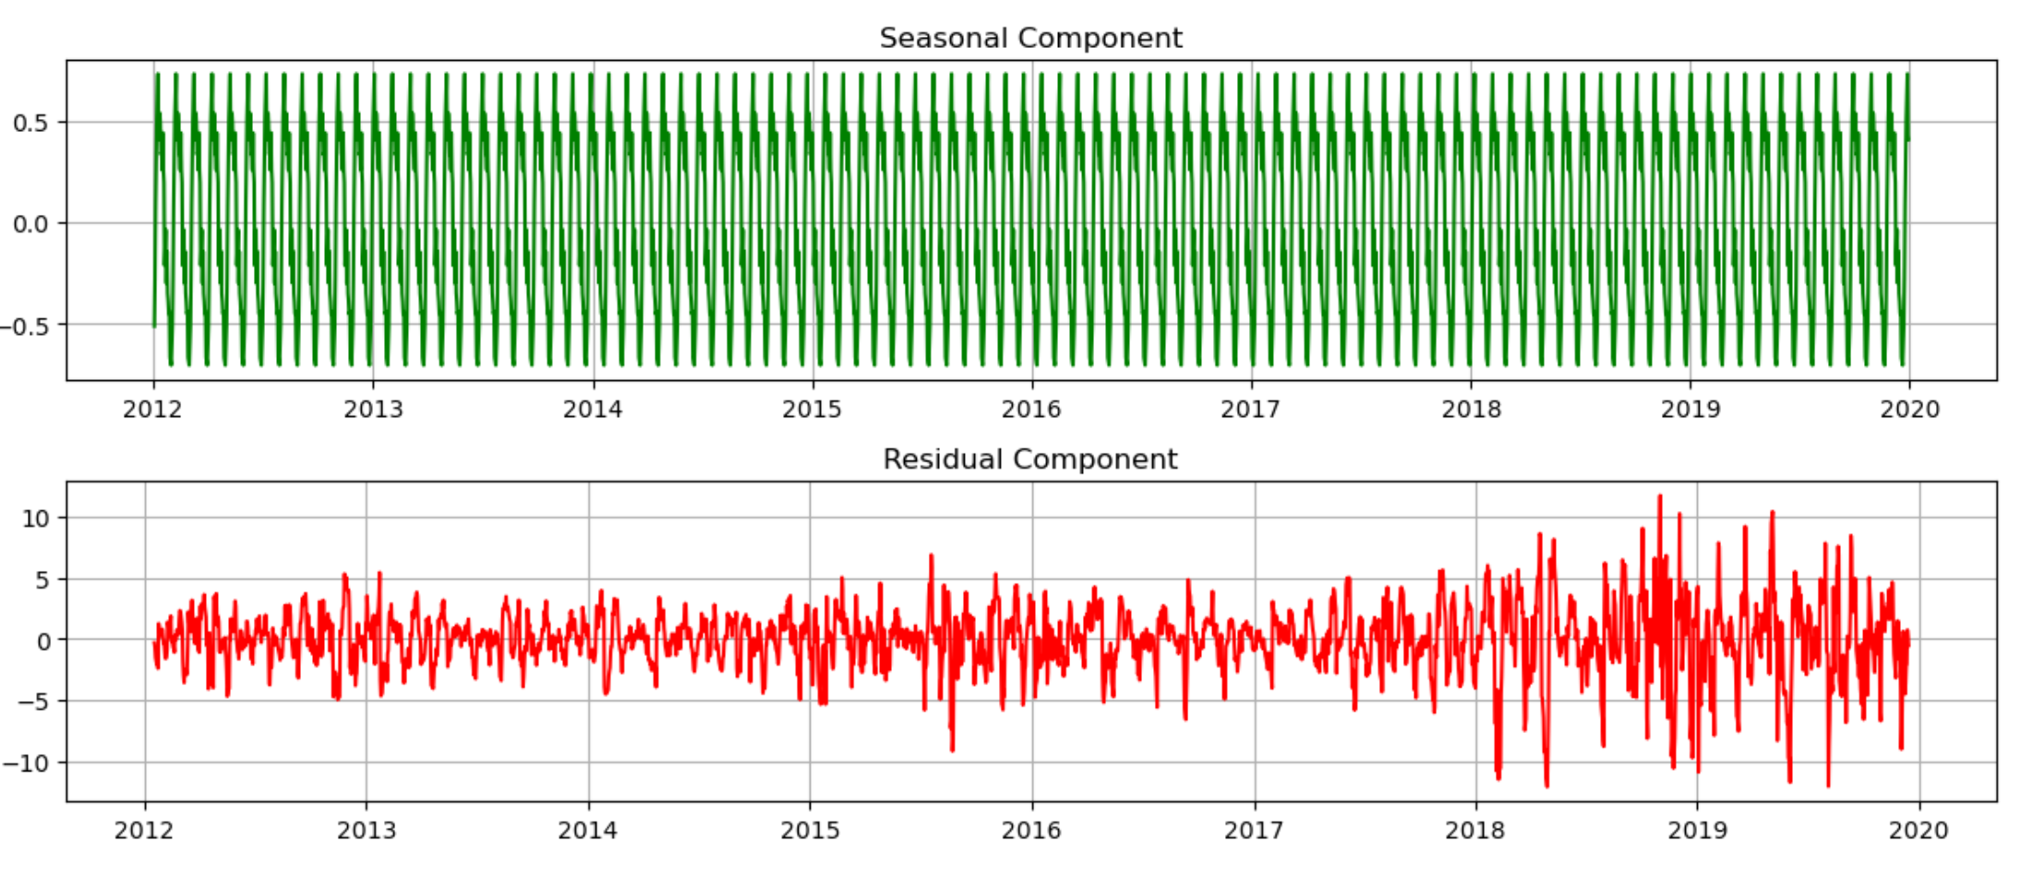
Time Series (Original, Trend, Seasonal, Residual)

Slide 15
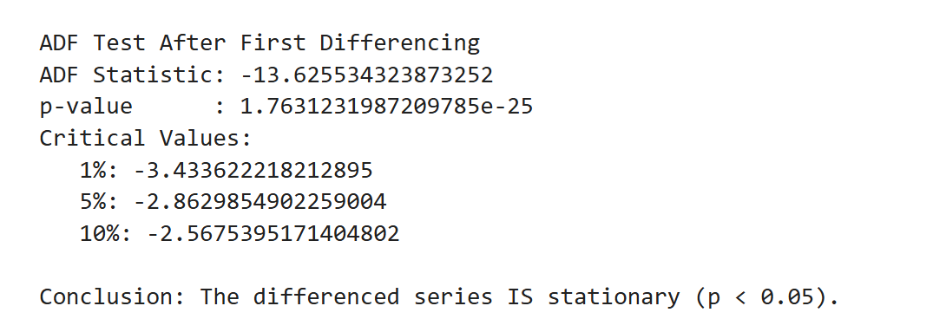
Stationarity Test (ADF Test)
After first differencing, the ADF test strongly confirms stationarity since the test statistic is far below critical values and the p-value is effectively zero.

Slide 16
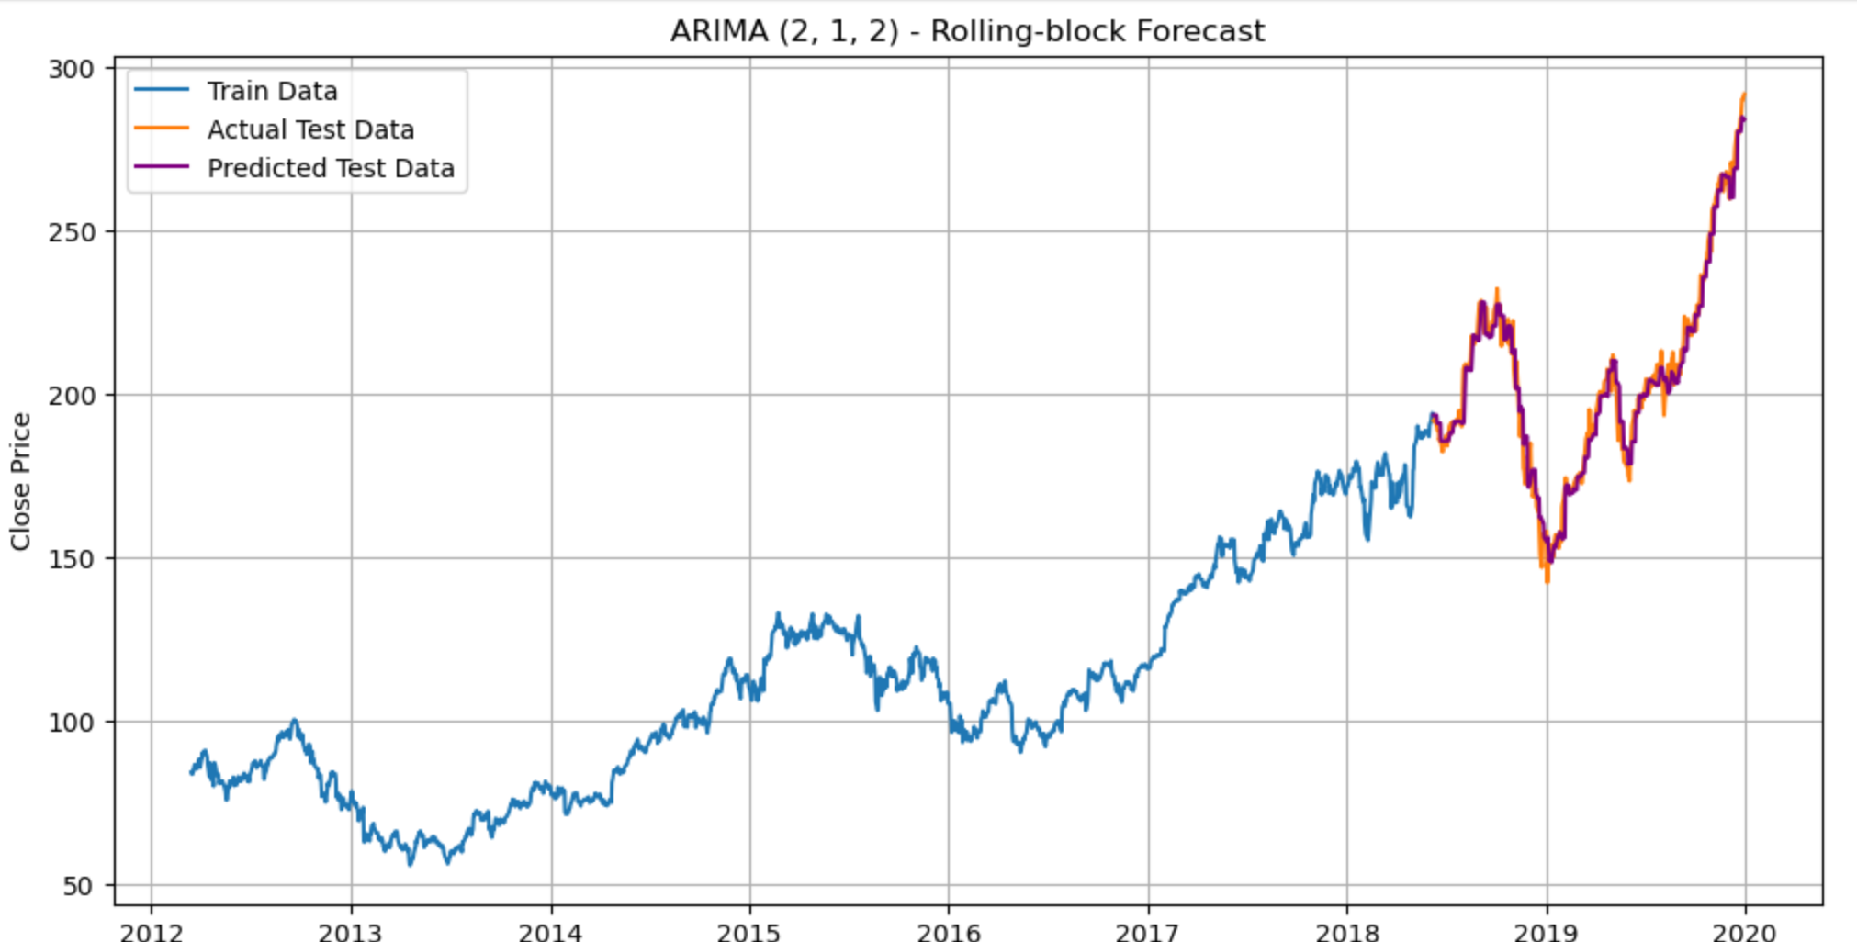
Rolling-Block Forecast on ARIMA (2,1,2)
BEST MODEL: (2, 1, 2)
BEST AIC: 6037.829531848647
Evaluation:
Rolling-block MAE: 3.9503370445564747
Rolling-block RMSE: 5.18361415512413
Predictions closer to actual trend → better visual overlap with test data.

Slide 17
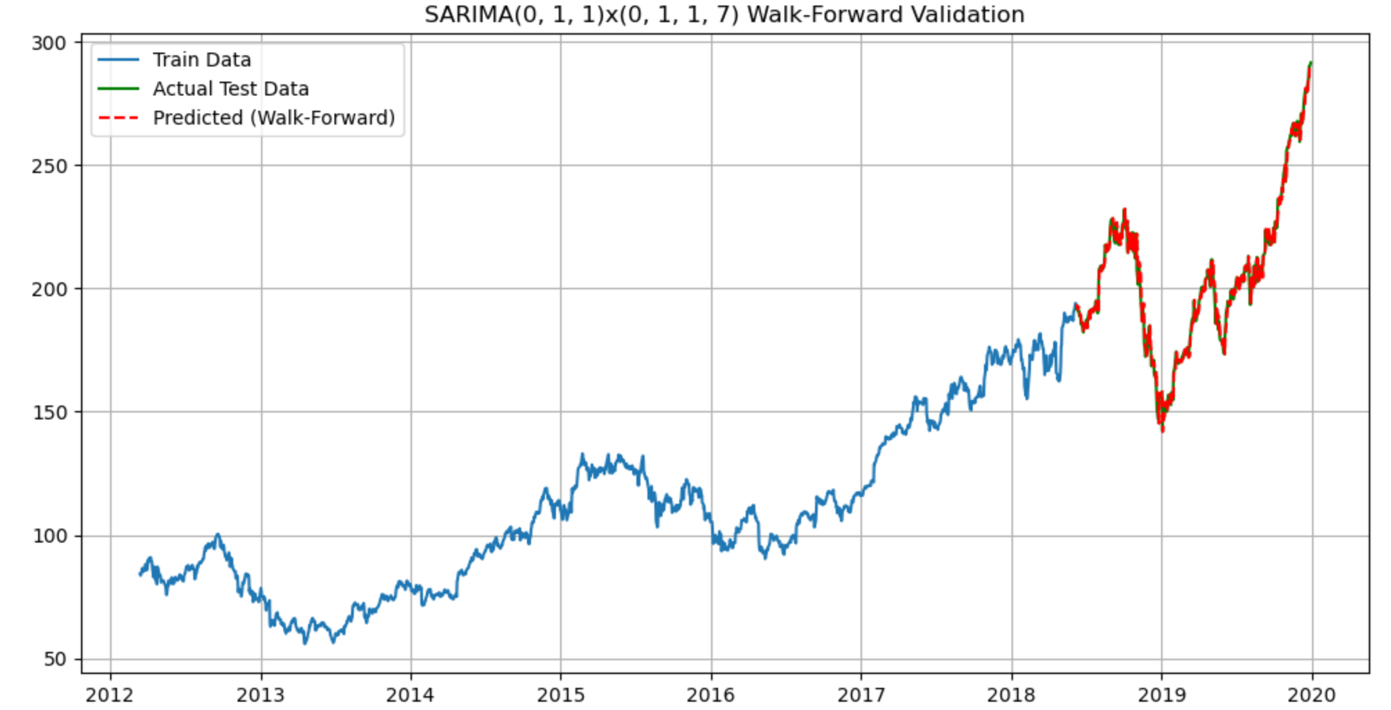
2. SARIMA with walk-forward validation
Best SARIMA order: (0, 1, 1)
Best seasonal order: (0, 1, 1, 7)
Starting Walk-Forward Validation...
Walk-Forward MAE: 2.51
Walk-Forward RMSE: 3.47
The SARIMA model demonstrated strong forecasting performance by effectively capturing both trend and weekly seasonality in Apple’s stock prices.

Slide 18
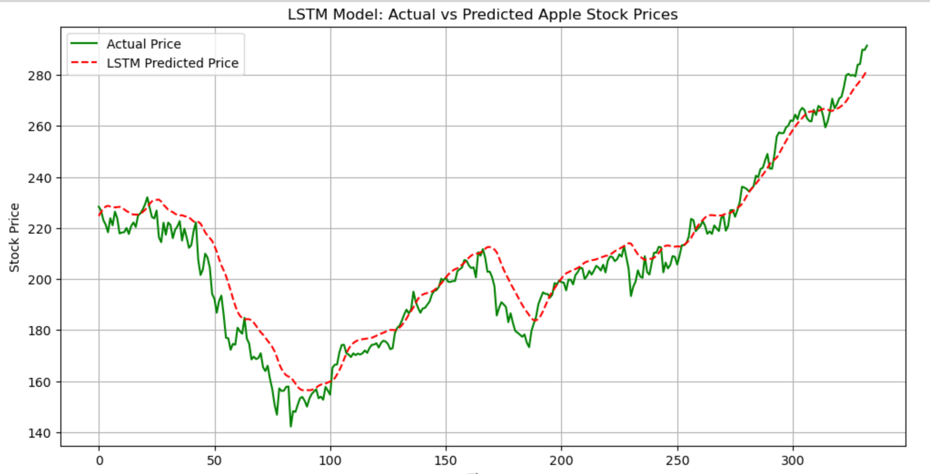
3.LSTM
LSTM model with 50 units, 20 epochs and 32 batch size was selected.
Evaluation:
Final LSTM MAE: 5.962632341298
Final LSTM RMSE: 7.8893533903465
The LSTM model accurately captures the overall trend of Apple stock prices, with slight smoothing and minor lag on sharp fluctuations.

Slide 19
Apple Stock Price Forecasting: Model Comparison and Selection
In this project, ARIMA, SARIMA, and LSTM models were developed and evaluated for forecasting Apple’s stock prices.
ARIMA provided a baseline statistical approach but showed limitations in capturing complex trends.
SARIMA performed the best among traditional time series models due to its ability to model seasonality and achieved the lowest error values.
The LSTM model, although slightly less accurate than SARIMA in terms of RMSE, offered greater flexibility in modeling non-linear patterns and smoother future forecasts.
SARIMA is selected as the final model due to its better performance and lower forecasting error compared to ARIMA and LSTM.

Slide 20
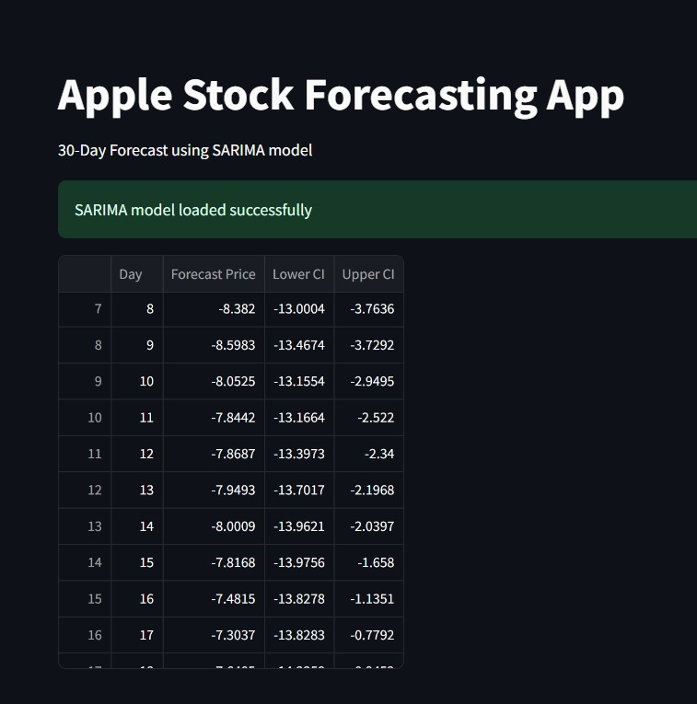
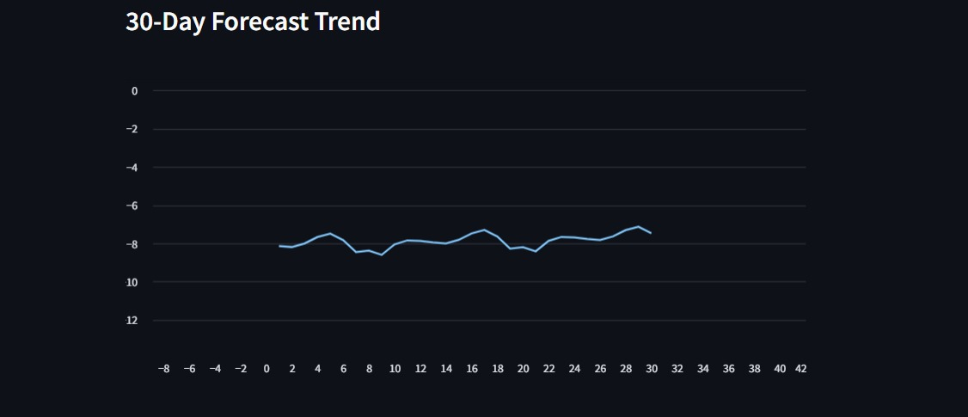
Screenshot of the App Page

Slide 21
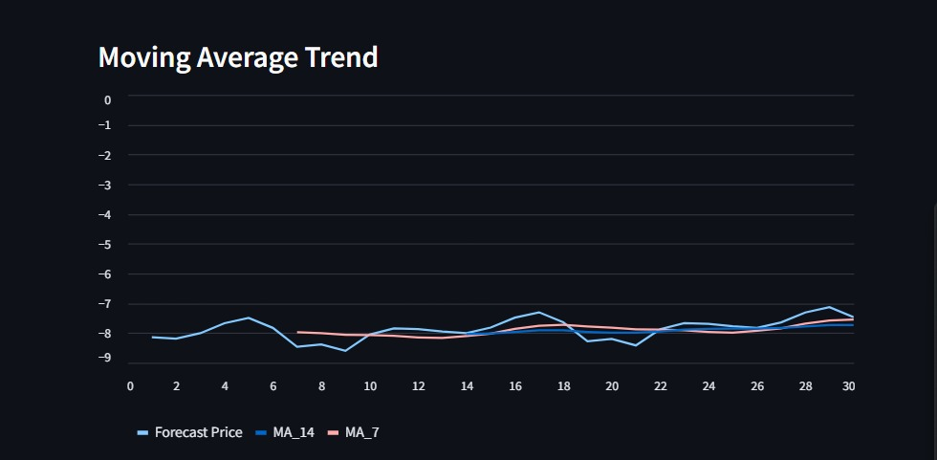
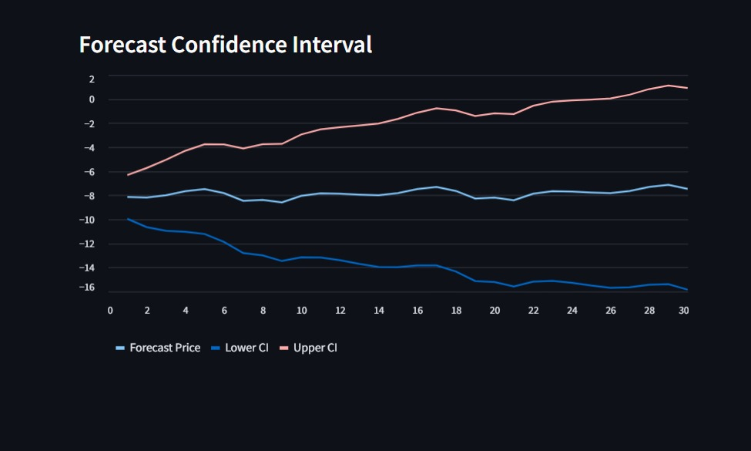
Screenshot of the App Page

Slide 22
Challenges Faced During the Project
Handling non-stationary stock price data before applying time-series models.
ARIMA initially produced flat forecasts, requiring rolling-block forecasting for better results.
Identifying correct seasonal parameters in SARIMA using grid search and walk-forward validation.
LSTM struggled with sharp peaks and sudden drops, causing prediction lag.
Hyperparameter tuning and model comparison increased complexity and computation time.
We faced environment mismatch and file-permission issues while integrating the SARIMA model into Streamlit.

Slide 23
THANK YOU

